Slide 1
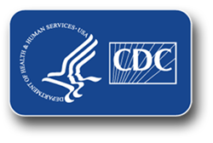
Healthcare Textiles:
Factors That Impact Cleanliness
Lynne M. Sehulster, PhD, M(ASCP)
Health Scientist
National Center for Emerging and Zoonotic Infectious Diseases
Division of Healthcare Quality Promotion
Hosted by Paul Webber
paul@webbertraining.com
www.webbertraining.com
October 16, 2014

Slide 2
Topics for Today
Healthcare laundry basics:
  Some observations
  Basic steps of the laundry process
  Antimicrobial activity in the wash cycle
Key observations from the report of the 2009 mucormycosis outbreak
Assess the holding/transport/storage stage for contamination opportunities
Fungi (and bacteria) as agents of textile biodegradation
Strategies to minimize environmental contamination of hygienically clean healthcare textiles (HCTs)
Antimicrobial treatment of textiles

Slide 3
Laundry and Infectious Diseases
Textiles contaminated with body substances can contain large numbers of microorganisms (10⁶ – 10⁸ cfu/100 cm² fabric)
Few reports in the literature link laundry to disease transmission when proper procedures are followed
Annual estimates for volume of laundry processed in U.S. health care: several billion lbs. higher than the 5 billion lbs. in the late 1980s
Continue current infection prevention practices

Slide 4
Observations from a Recent Study
135 personnel (45% physicians, 55% nurses) in surgical depts. (60%) and medical depts. (40%)
Nonpathogenic skin organisms isolated from all attire tested
Rate of contamination with pathogens higher in attire changed every 2 days compared to that for daily changes (p <.05)
Isolated pathogenic bacteria:
  Acinetobacter spp. 37% (89/238 cultures)
  Staphylococcus aureus 13% (32/238 cultures)
  Enterobacteriaceae 8% (18/238 cultures)
  Pseudomonas aeruginosa 3% (8/238 cultures)
Only skin bacteria isolated from 4 uniforms cultured immediately after receipt from the hospital laundry
  Bacterial loads significantly lower than on uniforms being worn
Wiener-Well Y, et al. Am J Infect Control 2011; 39: 555-9

Slide 5
Current Healthcare Textiles Standard in the U.S.
Standard for reusable textiles: Hygienically clean
  Not quantified for microorganisms, but assume textiles are generally rendered free of vegetative pathogens
  Through a combination of soil removal, pathogen removal, pathogen inactivation, contaminated laundry is rendered hygienically clean
  Carries negligible risk to healthcare workers and patients, provided that the clean textiles are not inadvertently contaminated before use
  Sensory attributes: visual, tactile, olfactory
Reusable surgical textiles: Sterilized
  CDC Guidelines for Environmental Infection Control in
  Health-Care Facilities, 2003:
  http://www.cdc.gov/hicpac/pdf/guidelines/eic_in_HCF_03.pdf
  ANSI/AAMI ST79:2010 and A1; ANSI/AAMI ST65:2008

Slide 6
AAMI: Hygienically Clean
Definition: “Free of pathogens in sufficient numbers to cause human illness.” (ANSI/AAMI ST 65:2008)
No one has ever defined what “sufficient numbers” means
  Underlying medical conditions may increase risk of infection by opportunistic pathogens

Slide 7
Main Steps of Healthcare
Laundry Processing
Collection of soiled textiles at point of use
Transport to laundry
Wash cycle:
  Flush, main wash, bleaching, rinsing, souring
Dried and pressed
Packaged, loaded into carts
Delivery back to the hospital

Slide 8
Conventional Laundering:
Log Reductions in Bioburden
In the wash, rinse cycles:
  Agitation: ~3 log unit reductions
  Addition of bleach: ~ 3 log unit reductions
In the dry cycle:
  ~ 1 – 2 log unit reductions
  From: Blaser MJ, et al. 1984; J Infect Dis 149: 48-57.
Post wash microbial burden ~10 – 100 CFU/cm²
Predominantly Gram-positive organisms

Slide 9
Alternatives to Hot-water Laundry
In-house laundries consume an average of 50% - 70% of the facility’s hot water (10% - 15% of the total energy used)
Water temperature may be regulated locally
Lower temperature (e.g., 22° – 50° C) wash cycles can be used with appropriate detergents and laundry additives
New detergents and processes (e.g., oxidative products) are being evaluated in Europe
Current problems associated with bleach use:
  Not all fibers and fabrics are compatible with bleach
  Chlorine + residual chlorhexidine gluconate (CHG) = brown stains

Slide 10
The Laundry Process: Log Reductions
Process | Gram Positive LR* | Gram Negative LR*
Pre –wash at 35° C | 0.73 – 2.47 | 0.70 – 1.16
Main wash at 45° C w/o pre-wash | 0.97 – 2.58 | 1.11 – 2.66
Main wash at 60° C w/o pre-wash | 1.34 - >5.56 | 3.71 - >5.6
E60 + 35: pre-wash at 35° C, main wash at 60° C | 1.91 - >7.68 | >5.6 - >7.76
Completed main wash at 75° C | >5.56 - >7.88 | >5.6 - >7.76
Disinfecting only at 75° C | >5.56 - >7.88 | >5.6 - >7.76
Complete 3-step cycle (with disinfection at 80° C) | >5.56 - >7.88 | >5.6 - >7.76
Detergent was mix of anionic and nonionic surfactants, phosphates
Bleach: H₂O₂ agent; Disinfecting agent was peroxyacetic acid, H₂O₂, acetic acid
Starting inocula: 10⁶ – 10⁷ CFU in 1 square cm
The disinfecting step by itself could not remove stains
E. faecium had the greatest survival; Gram positive > Gram negative
* LR = log reduction
Fijan S, et al. Diag Microbiol Infect Dis 2007; 57: 251-257
Notes:
10

Slide 11
U.S. EPA: Laundry Sanitizers and Disinfectants
OCSPP 810.2400: Fabrics and Textiles – efficacy data recommendations
Efficacy testing for antimicrobial pesticides intended to be used on fabrics and textiles, and which bear label claims as disinfectants or sanitizers
Sanitizers used on fabrics: 3 log₁₀ reduction
Disinfectants used in laundry facility: > 59 carriers out of 60 – no growth (carriers inoculated with > 10⁶ microbes)

Slide 12
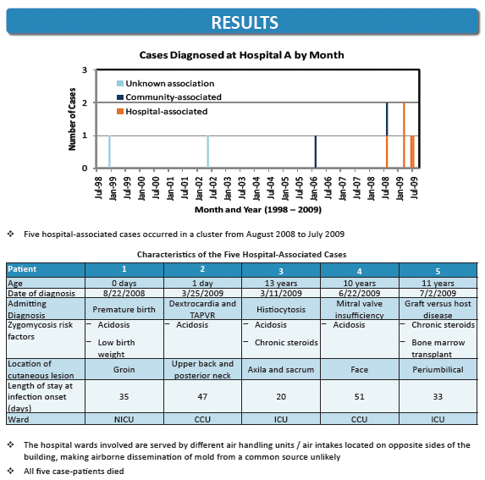
Duffy, J et al. Mucormycosis outbreak associated with hospital linens. Pediatr Infect Dis J 2014;33:472-476.

Slide 13
HACCP: An Assessment Tool for
Infection Prevention
HACCP
  Hazard Analysis and Critical Control Points
  Used extensively in the food service industry to help maintain product quality
  Look critically at the laundry facility and the laundry process to identify possible points at which contamination could be introduced, diminishing textile hygienic quality
  Helps to identify quality control strategies to prevent contamination of the product

Slide 14
HACCP Analysis for Possible Opportunities for Environmental Contamination
Laundry Contractor A:
  Facility was not climate controlled, ventilated with unfiltered outdoor air
  Clean HCTs in uncovered bins, exposed to outdoor air before loading into trucks
  Bins not lined with plastic that could be tied shut
Hospital A:
  Bins with clean HCTs held inside the loading dock receiving area for unspecified time
  HCTs placed on shelves in Central storage area
  Construction near the loading dock for the last 5 months of the epidemic period
Duffy, J et al. Mucormycosis outbreak associated with hospital linens. Pediatr Infect Dis J 2014;33:472-476.

Slide 15
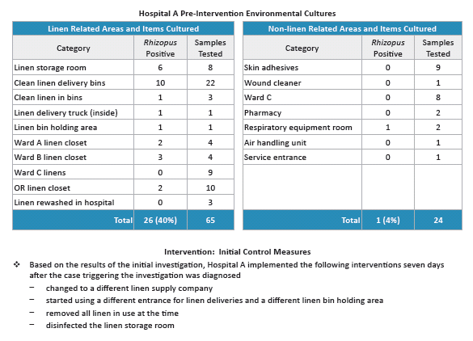
Duffy, J et al. Mucormycosis outbreak associated with hospital linens. Pediatr Infect Dis J 2014;33:472-476.

Slide 16
Conclusions From the Outbreak Investigation
HCTs were the most likely vehicle to have brought Rhizopus in contact with the patients
Genetic subtyping of fungal isolates supported this epidemiologic hypothesis
Contamination of clean HCTs with Rhizopus happened repeatedly, but might have been intermittent
HCTs should be laundered, shipped, and stored in a manner that minimizes exposure to environmental contaminants
Duffy, J et al. Mucormycosis outbreak associated with hospital linens. Pediatr Infect Dis J 2014;33:472-476.

Slide 17

Chain of Infection (COI)
Virulent pathogen:
  Bacteria, fungi, viruses, parasites, prions
Sufficient number of pathogen:
  Infectious dose
Mode of transmission:
  Contact, droplet, airborne
Portal of entry:
  Broken skin, mucous membrane, respiratory tract, ingestion
Susceptible host:
  Age, immunity, medical conditions
Other possible links include reservoir, portal of exit
Notes:
17
17

Slide 18
Questions Raised
Customers are beginning to question the standard
  Is hygienically clean good enough? Should we be doing something different?
  Should we be incorporating more antimicrobials into the laundry process on a routine basis?
Reports of customers asking laundry operators to do ATP sampling of laundry facility surfaces, cleaned textiles
  What does this mean?
  Should microbial sampling of clean textiles be implemented?
  Use of ATP monitoring of hard surfaces in a HACCP approach

Slide 19
Outbreaks Attributed to Laundered Healthcare Textiles (HCTs)
12 outbreaks in 43 years worldwide attributed to laundered, clean HCTs
  U.S. – 3, U.K. – 5, Japan – 3, Singapore – 1
  > 353 patients affected
  Pathogens identified:
    Aspergillus flavus
    Bacillus cereus (7/12, 58% of the outbreaks)
    MRSA
    Streptococcus pyogenes
    Rhizopus delemare
    Clostridium difficile
  Root causes included environmental contamination during transport, dust, improper storage conditions, washing machine malfunctions, inadequate drying, construction dust, recycled water in wash and rinse

Slide 20
Outbreaks Attributed to Soiled Healthcare Textiles (HCTs)
5 outbreaks of occupationally-acquired infections or exposure to hazardous pharmaceuticals in 43 years
  148 – 248 workers affected
  Pathogens/chemicals identified:
    Scabies
    Microsporis canis
    Salmonella hadar
    Hepatitis A virus
    Antineoplastic pharmaceuticals
Breach of infection prevention practices identified
  Improper handling created aerosols
  Failure to use appropriate PPE
  Exposures to fecal and other body substance contamination

Slide 21
Four Key Observations:
Infections and HCTs
Patient-to-patient transmission of infection has not as yet been reported in association with hygienically-clean HCTs
  Laundry processes carried out in accordance with recommended industry operational specifications for water quality, cycle parameters, proper laundry chemical selection and use, and proper equipment maintenance
Outbreaks involve environmental contamination and failure to maintain HCT cleanliness after washing and drying
  Root causes identified and corrected
  Problems with storage are most frequently identified
Occupational infection or chemical exposure involve failure to use PPE and follow standard infection prevention procedures when handling soiled HCTs
Rare events, but is underreporting at work here?

Slide 22
Biodegradation of Textiles
Textiles, especially those containing natural fibers, are readily attacked by microbes
  Some processing and finishing agents (e.g., dyes) are also vulnerable
  Over time loss of strength, discoloration, change of appearance, odor
Fungi are the most important microbial class associated with biodegradation
Three things necessary for fungal growth:
  Food source (e.g., cellulose)
  Moisture
  Favorable environmental conditions (e.g., temperature, humidity)
Szostak-Kotowa J. Biodeterioration of textiles. Int Biodeterioration Biodegradation 2004; 53: 165-170.

Slide 23
Biodegradation of Textiles
There are two main ways to control and/or prevent biodegradation of HCTs:
Control of environmental and physical conditions of clean HCTs, or
Use antimicrobial treatments
Szostak-Kotowa J. Biodeterioration of textiles. Int Biodeterioration Biodegradation 2004; 53: 165-170.

Slide 24
Laundry Holding/Transport / Storage
Controlling the environmental conditions is considered to be the best means of protecting textiles
Clean HCTs touch clean surfaces
    That includes clean hands and worker uniforms
HCTs should be as dry as practical prior to bundling or packaging
Unwrapped HCTs should be stored and transported using strategies to prevent inadvertent contamination by soil or body substances
    Covered containment, either bins, carts, or shelves
Notes:
24

Slide 25
Laundry Transport / Storage
Separate clean textiles from contaminated textiles when transporting in a vehicle
Physical barriers and/or space separation
Clean, unwrapped textiles can be stored in a clean location for short periods of time
Unwrapped textiles should be stored so to prevent inadvertent contamination by soil or body substances
This is the part of the overall process that is most vulnerable to outside contamination

Slide 26
Climate Control via Ventilation: Key Engineering Specifications
Clean HCT Storage:
  Temperature: 72 - 78° F
  Relative humidity (RH): NR*
  Air changes/hour (ACH): 2
  Airflow direction: Positive
Surgical Pack Room Storage:
  Temperature: < 78° F
  Relative humidity: < 70%
  Air changes/hour (ACH): 2
  Airflow direction: Positive
Hold/Staging at the Laundry:
  ?
Why this is important:
Fungi grow rapidly at RH > 80%
Keeping the ventilation parameters consistent helps to minimize microbial growth
  Trapped excess moisture due to packaging may create opportunities for growth when RH fluctuates
  May cause pockets of high humidity within the HCT bundle that may be RH >80%
  This increase can be as much as 20% over ambient humidity
Higher temperatures encourage fungal growth
FGI. Guidelines for Design & Construction of Hospitals & Outpatient Facilities. 2014 Ed. FGI, Dallas, TX
ANSI/ASHRAE/ASHE Standard 170-2013. Ventilation of Health Care Facilities. 2013. ASHRAE, Atlanta, GA
HLAC Accreditation Standards for Processing Reusable Textiles for Use in Healthcare Facilities, 2011. Plainfield, IL
ANSI/AAMI ST65:2008 (R2013). Processing of Reusable Surgical Textiles for Use in Healthcare Facilities, 2009. Arlington, VA
Montegut D, Indictor N, Koestler RJ. Fungal deterioration of cellulosic textiles: a review. Int Biodeterioration 1991; 28:209-226

Slide 27
Laundry Holding/Transport / Storage: Area Cleanliness and Dust Control
  Evaluate HCT storage area in the hospital for ways to minimize dust intrusion
    Self-closing doors help to maintain positive pressurization
    Location of HCT storage room relative to the loading dock and other services
    Amount of traffic through the room
  Establish hospital policy for regular cleaning and disinfection of the room’s storage surfaces
  Where are clean HCTs unloaded in the hospital?
  Visual inspection of outermost bundle surfaces

Slide 28
Antimicrobial Chemical Treatments
Different approaches to adding chemical treatments:
  Impregnation of the fiber (e.g., copper)
  Treatment of the fabric before final garment/item construction
  Treatment of the garment/item (e.g., add/recharge an antimicrobial residual)
Function of the antimicrobial treatment
  Protection of the fabric/garment to maintain textile function
  Hygienic treatment
Antimicrobial treatments for hygienic purposes:
  Low toxicity to humans, minimize skin irritation
  Should not leach from the fabric (e.g., when moistened by sweat)
  Should not interfere with proper function of the textile
  Low cost, withstand repeated washings
Szostak-Kotowa J. Bioterioration of textiles. Int Biodeterioration Biodegradation. 2004; 53:165-170.

Slide 29
A Short List of Antimicrobial Chemicals for Textiles
Quaternary ammonium compounds plus acrylic copolymer fluid repellent
Chitosans and chitooligosaccharides
Quaternary ammonium compounds plus organosilane (forming a silicon-nitrogen carbon polymer)
Hydrophobic N-alkyl plus benzophenone containing polyethylenimine
Silver (Ag) nanoparticles
Copper (Cu) nanoparticles
Gold (Au) nanoparticles
Siloxane sulfipropylbetaine (SSPB)
Titanium dioxide (TiO₂)
Ag nanocomposite with TiO₂ and citric acid as a crosslinker
Triclosan

Slide 30
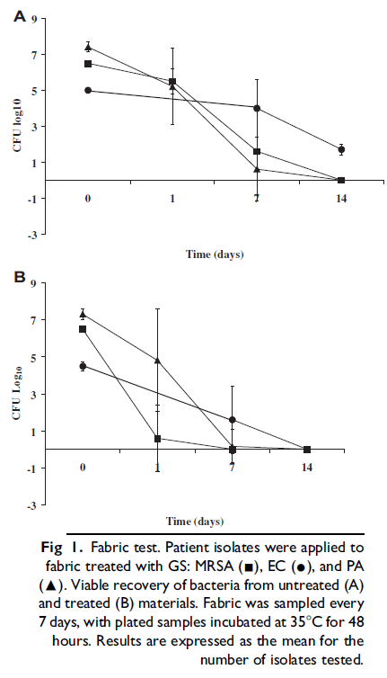
Treatment of Fabric with Quaternary Ammonium/Organo-silane During the Wash Process
From: Baxa D, et al. Am J Infect Control 2011; 39: 483-7

Slide 31
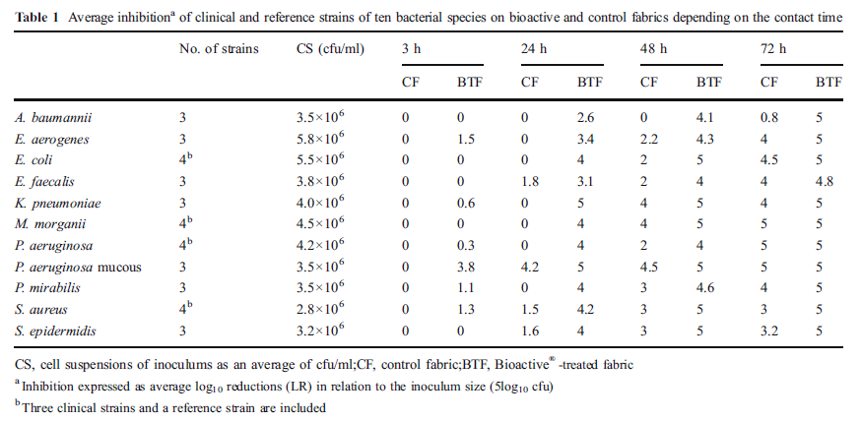
Log Reductions on Untreated Fabric (Control) and Silver Treated Fabric
Mariscal A, et al. Eur J Clin Microbiol Infect Dis 2011; 30: 227-32

Slide 32
Dermatophyte Susceptibility to Selected Antimicrobial Textiles
Growth inhibition of the Trichophyton species assessed as follows:
0 = no growth visible to the naked eye
1 = no growth visible to the naked eye, but visible under the microscope
2 = 25% growth compared to the negative control
3 = 50% growth compared to the negative control
4 = > 50% growth compared to the negative control
5 = growth comparable to the negative control
Inhibition of Candida albicans shown as log₁₀ reductions. Standard deviation shown in parentheses.
Key: DDAC = didecyldimethylammonium chloride
PHMB = poly-hexamethylenbiguanide
AgCl = silver chloride
Cu = copper
From: Hammer TR, et al. Dermatophyte susceptibility varies toward antimicrobial textiles. Mycoses 2012; 55: 344-351.

Slide 33
Chitosans and Chitooligosaccharides
Antimicrobial Activity - Candida albicans
Figure 3. Effects (Average + Standard Deviation) of Different MW Chitosans and COS Upon Candida albicans
Panel A: 1 hour exposure Panel B: 4 hour exposure
Black bars: incubated in Müller-Hinton broth White bars: incubated in cotton fabric
From: Fernandes JC et al. J Microbiol Biotechnol 2010; 20: 311-318.

Slide 34
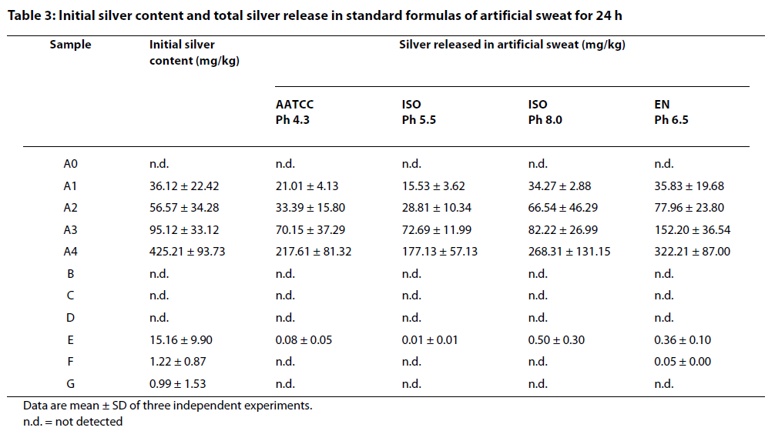
Effect of Artificial Sweat on Silver Leaching from Treated Fabrics
From: Kulthong K, et al. Part Fib Toxicol 2010; 7: 8-16

Slide 35
EPA: Treated Article Exemption
According to FIFRA, “treated articles” refer to articles or products that are treated with an antimicrobial pesticide to protect the article or product themselves.
Treated Articles Exemption:
  An article or substance treated with or containing a pesticide to protect the article or substance, if the pesticide is registered for such use
  The Treated Articles Exemption is available only for the protection of the product and not for public health uses
    Odor control, prevention of deterioration
Products bearing a public health claim must be registered in addition to the registration of the antimicrobial pesticide
http://www.epa.gov/pesticides/factsheets/treatart.htm

Slide 36
Quality Issues for Consideration
Conduct risk-benefit analysis
Potential toxicologic and allergic side effects
  Does exposure alter the microbial ecology of the skin, skin integrity?
Potential selection for resistant microorganisms with long-term use
Potential environmental issues
  Biodegradability, toxicity to plants, marine life
Persistence of the antimicrobial effect
  Is recharge needed, or is another treatment necessary?
Can consistent adherence to existing infection prevention practices achieve similar results?
Need to document an impact on healthcare-associated infection (HAI) rates while using antimicrobial treatment of textiles

Slide 37
Resources for More Information
CDC:
  Guidelines for Environmental Infection Control in Health-Care Facilities: http://www.cdc.gov/hicpac/pdf/guidelines/eic_in_HCF_03.pdf
  Guidelines for Disinfection and Sterilization in Healthcare Facilities: http://www.cdc.gov/hicpac/pdf/guidelines/Disinfection_Nov_2008.pdf
  HAI Prevention Tool Kit: http://www.cdc.gov/HAI/prevent/prevention_tools.html
    Options for Evaluating Environmental Cleaning
    Appendices to the Conceptual Program Model for Environmental Evaluation
    CDC Environmental Checklist for Monitoring Terminal Cleaning
    CDC Environmental Checklist
    Environmental Cleaning Evaluation Worksheet (Excel format)
    CDI Prevention Tool Kit
EPA:
  Selected EPA-Registered Disinfectants: http://www.epa.gov/oppad001/chemregindex.htm
  Pesticide Product Label System: http://www.epa.gov/pesticides/pestlabels/index.htm

Slide 38

Thank You!
“Protect patients, protect healthcare personnel, and promote safety, quality, and value in the healthcare delivery system.”
The findings and conclusions in this report are those of the authors and do not necessarily represent the official position of the Centers for Disease Control and Prevention.
National Center for Emerging and Zoonotic Infectious Diseases

Slide 39

October 23 INFECTION PREVENTION IN OUTPATIENT ONCOLOGY SETTINGS
Dr. Alice Guh, Division of Healthcare Quality Promotion, Centers for Disease
Control and Prevention
November 5 (Free WHO Teleclass – Europe)
PUBLIC REPORTING AND DISCLOSURE OF HAI RATES:
POSITIVE IMPACT OR CONFUSION?
Dr. Michael Borg, St. Luke’s Hospital, Malta
Sponsored by the World Health Organization
November 6 (Free Teleclass)
CBIC IS MAKING THE CERTIFICATION PROCESS WORK FOR ALL !
Craig H Gilliam and Lita Jo Henman, Certification Board of Infection Control
November 13 EMERGING RESPIRATORY VIRUSES: ARE HEALTHCARE WORKERS PROTECTED?
Dr. Virginia Roth, The Ottawa Hospital

Slide 40


